Slide 1
System Provisioning in a Cloud Scale Environment
Scott Jaffa

Slide 2
Launch machine
$ onevm deploy 24
…
$ onevm list
ID USER GROUP NAME STAT UCPU UMEM HOST TIME
8 oneadmin oneadmin CentOS Server 6 runn 0 1.3G node1 219d 01h25
17 oneadmin oneadmin ttylinux1 runn 2 256M node1 218d 21h15
18 oneadmin oneadmin ttylinux1 runn 2 256M node1 218d 21h15
19 oneadmin oneadmin ttylinux12 runn 2 256M node1 218d 12h58
24 oneadmin oneadmin ttylinux12 runn 2 256M node1 218d 12h58
28 oneadmin oneadmin ttylinux12 pend 0 0K 218d 12h58
$ onevm show 24
…
ID NETWORK VLAN BRIDGE IP MAC
0 Net1 no br0 10.0.0.122 02:00:0a:00:00:7a
scott$ ssh root@10.0.0.122
root@10.0.0.122's password:
Chop wood, carry water.
# hostname
ttylinux_host

Slide 3
Agenda
Introduction and background
Definitions
Cloud architecture
Machine Lifecycle
Tools
Provisioning workflow
Questions?

Slide 4
About Me
Scott Jaffa
Linux System Engineer
scott@jaffafamily.org
Notes:
I’m a hands on Linux System Architect by function.
One of my interests is the challenge of designing scalable infrastructure.

Slide 5
About This Presentation
Home Lab Project
Problem – how do I provision machines such that they are efficiently managed?
Objective – Create an environment where 100 potentially unique, fully configured, and operational machines can be launched within 15 minutes
Be able to scale to many thousands of machines
Assumes a functioning environment
Notes:
Assuming a functioning environment

Slide 6
Definitions
Cloud Computing – On-demand self-service, broad network access, resource pooling, rapid elasticity, measured service - NIST
Cloud Scale – Infrastructure too large to individually manage machines
Virtualization – Virtualization is a platform which abstracts out the hardware
http://csrc.nist.gov/publications/nistpubs/800-145/SP800-145.pdf
Notes:
Like pornography; hard to define but you know it when you see it.
I shall not today attempt further to define the kinds of material I understand to be embraced within that shorthand description …. But I know it when I see it,
—Justice Potter Stewart

Slide 7
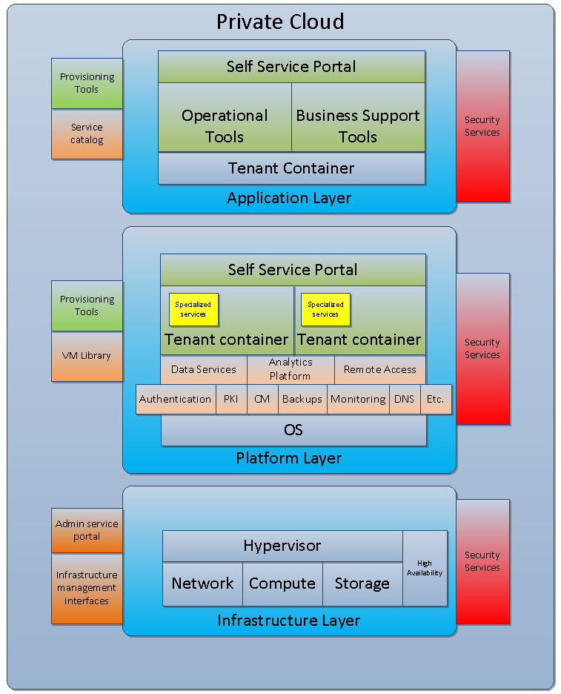
Cloud
Notes:
Talk through diagram

Slide 8
Machine Lifecycle
Machine requested
Provisioning tool deploys image
Machine registered with directory
Needed software installed
Machine registered with management software
Configuration Manager defined machine state
Machine registered with monitoring software
Machine runs
Machine is decommissioned

Slide 9
The Foreman
Provisioning tool
Provides front end CLI and GUI interface for user interaction
Connects to the various management components
Machine requested
The Foreman deploys image
The Foreman registered with directory
Needed software installed
Machine registered with management software
Configured manager defined machine state
Machine registered with monitoring software
Machine runs
Machine is decommissioned

Slide 10
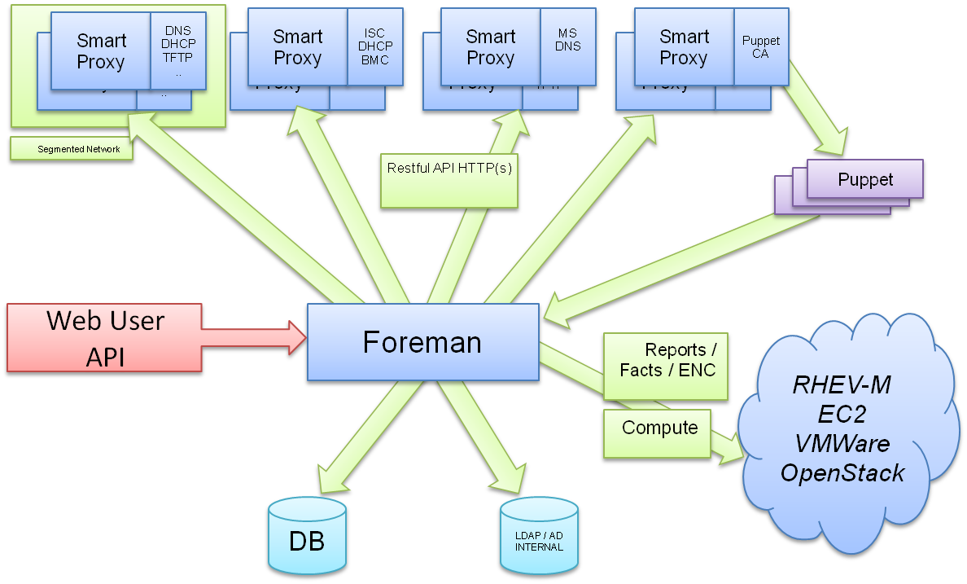
The Foreman
http://theforeman.org/manuals/1.1/index.html#ForemanArchitecture

Slide 11
FreeIPA
Directory server (AD for Linux)
Multi-master replication
DNS server (through BIND LDAP connector)
Kerberos
Certificate Authority
Web and command line interfaces
The Foreman registered with FreeIPA
Machine requested
The Foreman deploys image
Needed software installed
Machine registered with management software
Configured manager defined machine state
Machine registered with monitoring software
Machine runs
Machine is decommissioned

Slide 12
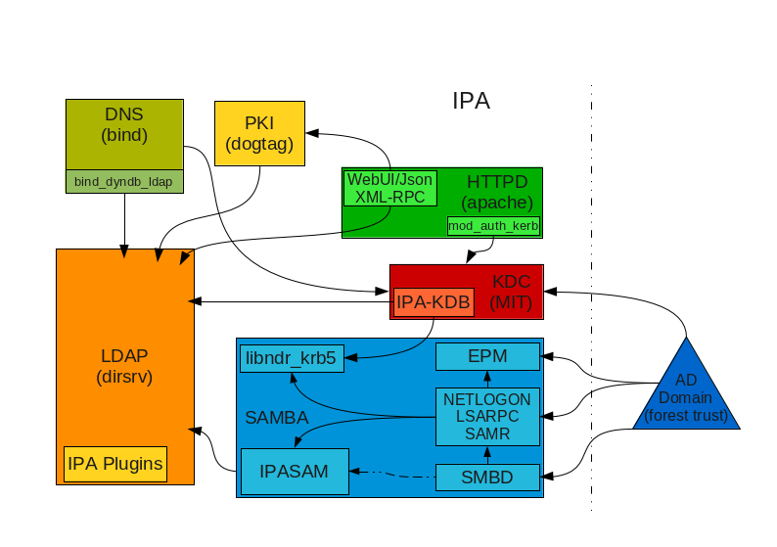
FreeIPA
http://www.freeipa.org/page/IPAv3_Architecture

Slide 13
Puppet
Lifecycle management engine
Functionality
System configuration management
Change management
Disaster recovery
System configuration reporting
Machine requested
The Foreman deploys image
The Foreman registered with directory
Needed software installed by Puppet
Machine registered with management software
Puppet defined machine state
Machine registered by Puppet with Nagios
Machine runs
Machine is decommissioned

Slide 14
Puppet
Version Control
Modules
Puppetmasterd
Puppetca
Configuration
Authentication
Facts, Reports
Client

Slide 15
Katello
Wrapper software for system management
Provides
Software repositories
Patching management
Provisioning
Configuration Management
Environment aware
Machine requested
The Foreman deploys image
The Foreman registered with directory
Needed software installed with Puppet
Machine registered with management software
Configured manager defined machine state
Machine registered with monitoring software
Machine runs
Machine is decommissioned

Slide 16
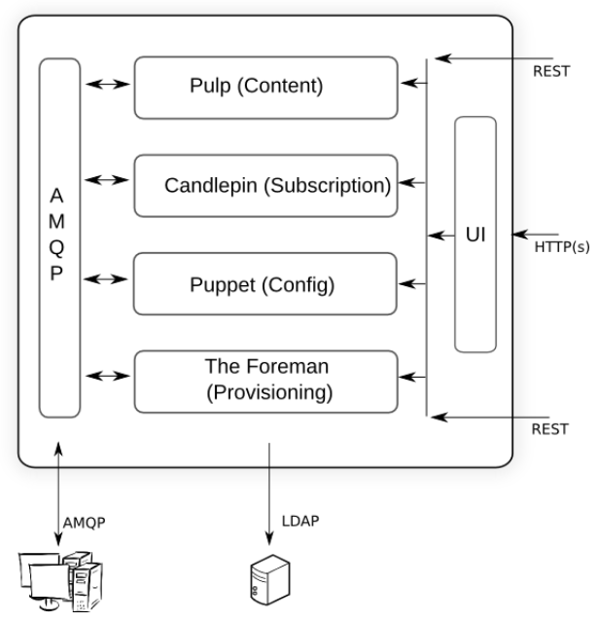
Katello
http://www.redhat.com/summit/2011/presentations/summit/whats_next/thursday/summit-2011.warner_sanders_t_1400_future_of_satellite-v7.pdf
Notes:
Uses AMQP – Advanced Message Queuing Protocol

Slide 17
Machine Lifecycle
Machine requested
The Foreman deploys image
The Foreman registered with FreeIPA
Needed software installed by Puppet
Machine registered with Katello
Puppet defined machine state
Machine registered with Nagios
Machine runs
Machine is decommissioned

Slide 18
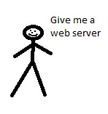
Provisioning Workflow Non Technical
Process is transparent to requestor
MAGIC
Web Server

Slide 19
Provisioning Workflow Service Interactions
User requests new machine
CMDB
DNS Server
Provisioner
Directory server
CA
Virtualization Controller
VM
System Management software
Software Repository

Slide 20
The Foreman
-User requests new machine
-Machine Type
-Machine function
-Deployment location
Client VM
Provision machine in VM environment
The Foreman Interface
Puppet Node classification
Configure certificates on machine
Configure machine to join directory server
Create machine on directory server

Slide 21
FreeIPA
-The Foreman sends system information
-Requests key to join machine to directory
Client VM
CA create certificates
FreeIPA Interface
LDAP create entry
Create pre shared key for initial join
DNS create entry
Kerberos create trust principle

Slide 22
Katello
-Foreman or Puppet request client subscribe to software repository
Client VM
Send packages to client
Katello Interface
Join host to repository

Slide 23
Puppet
-Foreman classifies client
Client VM
Applies configuration to client
Puppet Interface
Configures any needed software repositories
Configures any needed monitoring

Slide 24
Provisioning Workflow Service Interactions
User requests new machine
CMDB
DNS Server
FreeIPA
Provisioner
The Foreman
Directory server
FreeIPA
CA
FreeIPA
Virtualization Controller
VM
Client
System Management software
Puppet
Software Repository
Katello

Slide 25
Advantages
Security for free
Known baseline
Dev & test environments
Disaster recovery
Audit tracking
Documentation
Rapid updating

Slide 26
Questions?
Scott Jaffa
scott@jaffafamily.org

Slide 27
References
NIST Cloud Computing definition http://csrc.nist.gov/publications/nistpubs/800-145/SP800-145.pdf
Foreman Architecture Diagram http://theforeman.org/manuals/1.1/index.html#ForemanArchitecture
FreeIPA Architecture Diagram http://www.freeipa.org/page/IPAv3_Architecture
Katello Architecture Diagram http://www.redhat.com/summit/2011/presentations/summit/whats_next/thursday/summit-2011.warner_sanders_t_1400_future_of_satellite-v7.pdf

Slide 28
Backup Slides

Slide 29
Virtualization Technologies Related to Assumptions
Compute – Basic hardware
Storage – GlusterFS
Network – VLANs
Hypervisor – KVM
Controller – OpenNebula
High Availability – Gluster Replication and OpenNebula

Slide 30
Configuration Specifics – IPA PKI + Puppet
IPA Server:
# enrolling the puppet master service
$ ipa service-add puppetmaster/puppetmaster.example.com
# enrolling the puppet agent service
$ ipa service-add puppet/puppet.example.com

Slide 31
# install latest puppet-server
# (yum install puppet-server is a couple minor versions behind)
# version 3.2 fixes a CA bug that isn't in the yum repo
$ rpm -ivh http://yum.puppetlabs.com/fedora/f19/products/i386/puppetlabs-release-19-2.noarch.rpm
$ yum install -y http://yum.puppetlabs.com/fedora/f19/products/x86_64/puppet-server-3.2.4-1.fc19.noarch.rpm
# stop the puppetmaster service since we'll be using apache
$ service puppetmaster stop
# install additional requirements
$ yum install -y mod_nss mod_passenger

Slide 32
rm /etc/httpd/alias/*.db
certutil -d /etc/httpd/alias/ -N
chmod 644 /etc/httpd/alias/*.db
ipa-getcert request -r -K puppetmaster/puppet.lab.the-depths-of-hell.com -d /etc/httpd/alias -n puppetmaster/puppet.lab.the-depths-of-hell.com
ipa-getcert request -K puppet/puppet.lab.the-depths-of-hell.com -D puppet.lab.the-depths-of-hell.com -k /var/lib/puppet/ssl/private_keys/puppet.lab.the-depths-of-hell.com.pem -f /var/lib/puppet/ssl/certs/puppet.lab.the-depths-of-hell.com.pem
certutil -K -d /etc/pki/nssdb -a
pk12util -o keys.p12 -n "IPA Machine Certificate - puppet.lab.the-depths-of-hell.com" -d /etc/pki/nssdb
openssl pkcs12 -in keys.p12 -out /var/lib/puppet/ssl/private_keys/puppet.lab.the-depths-of-hell.com.pem -nodes
certutil -L -d /etc/pki/nssdb -a -n "IPA CA" > /var/lib/puppet/ssl/certs/ca.pem
certutil -d /alias -A -n "IPA CA" -t "CT,," -a -i /var/lib/puppet/ssl/certs/ca.pem

Slide 33
Puppet Agent setup
On the Puppet Agent:
Installation:
# install latest puppet (agent) # (yum install puppet-server is a couple minor versions behind) # version 3.2 fixes a CA bug that isn't in the yum repo $ rpm -ivh http://yum.puppetlabs.com/fedora/f19/products/i386/puppetlabs-release-19-2.noarch.rpm $ yum install -y http://yum.puppetlabs.com/fedora/f19/products/x86_64/puppet-3.2.4-1.fc19.noarch.rpm
Setup certificates for the agent
$ ipa-getcert request -K puppet/puppet.example.com -D puppet.example.com -k /var/lib/puppet/ssl/private_keys/puppet.example.com.pem -f /var/lib/puppet/ssl/certs/puppet.example.com.pem
Setup the agent configuration in /etc/puppet/puppet.conf, by editing/adding the [agent] & [main] block:
[main] # <--snip--> server = 'puppetmaster.example.com' certname = 'puppetmaster.example.com' # <--snip--> [agent] # <--snip--> certificate_revocation = false certname = 'puppet.example.com' # <--snip-->
Test the entire setup in puppet agent:
# open up port for Puppet $ firewall-cmd --add-port=8140/tcp # test to see if the setup works $ puppet agent --test # you'll probably get a catalog error if you have no catalogs # setup with your puppet master

